Slide 1
Techniques to meet skills requirements
Learning Aim D

Slide 2
Recruitment
Recruitment is one way of filling the skills gaps in the workplace, perhaps to:
▸ replace a leaver
▸ bring additional skills to a team for a new product line
▸ increase productivity
▸ respond to a change in business direction, or
▸ compete with other market forces.

Slide 3
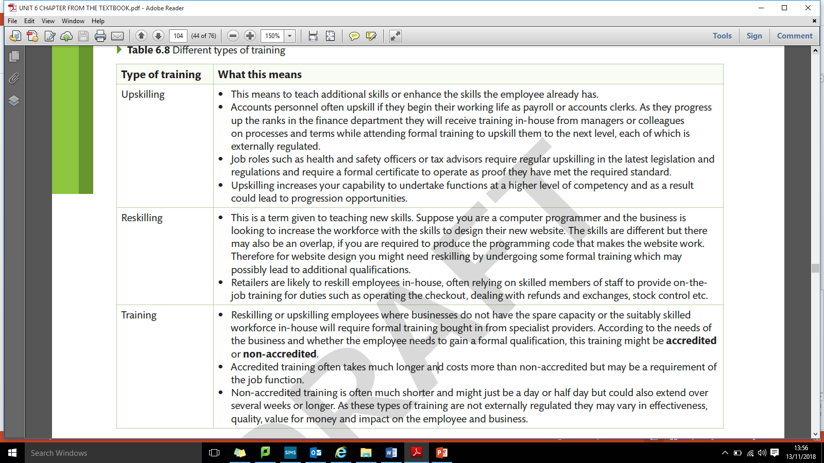
Upskilling/reskilling/training

Slide 4
Outsourcing
Another way for managers to meet skills requirements is to outsource.
Outsourcing is when a business obtains goods or a service by contract from an outside supplier
Computer technology company Dell outsource their customer support, as do many other businesses.
While it could be argued that outsourcing does not always meet customer needs, businesses are motivated to outsource for different reasons, often to reduce cost.

Slide 5
Changing job roles
It may not suit all employees but changing job roles is not only an effective technique for maintaining motivation but also for getting the right people into a job with the skills to maximise productivity.
For example, a family business will ensure that every member of the workforce is traceable back to the role they played.

Slide 6
Re-structuring
Re-structuring occurs when businesses need to re-position their workforce to where the skills are required.
Unfortunately there are often negative connotations associated with re-structuring, implying that there will be a surplus workforce who do not have the right skills and therefore are no longer required.

Slide 7
Training and Development
The purpose of training needs analysis
Types of training; internal/external, on the job/off the job, mentoring, coaching
Effectiveness of training

Slide 8
Performance Appraisal
Individual and group targets
Assessment of individual and group performance
Providing employee feedback
Identifying training needs

Slide 9
Types and impact of Appraisal
Types of appraisal
Self – assessment
Management by objectives
Ratings scales
360° appraisal
Impact of appraisal
Impact on the individual
Impact on the business
Ratings scales
360° appraisal

Slide 10
Task:
Complete assessment practice 6.4 on page 113.

